Slide 1
NiRA-An Engine For Job Creation and Economic Growth
Ope Odusan
Nigerian Internet Registration Association
Chief Operating Officer
oodusan@nira.org.ng
http://www.nira.org.ng
Tel: 0808 208 2766

Slide 2
NiRA-Background
.ng is Nigeria’s country code, and implicitly, a Nigerian identity on the internet.
This important national resource is managed by Nigeria Internet Registration Association (NIRA)
The Nigeria Internet Registration Association (NiRA) was founded on March 23, 2005 as a stakeholder-led organisation, charged with the management of the nation's Country Code Top Level Domain Name (ccTLD), .ng..
NiRA's establishment was the end of a long period of inactivity and dispute on the appropriate management of this important National Resource. Coordinated by the National Information Technology Development Agency (NITDA). Stakeholders within Nigeria’s Internet community participated in its formation.
Our Current Executive President is Mrs Mary Uduma who heads the 8 members executive board.

Slide 3
NiRA-Platform for E-Commerce in Nigeria
E-Commerce/Electronic mail communication begins with a Domain Name
Security of web transactions through Certificate Authority via SSL/https
Protection of Trademarks and other Intellectual properties (integration with CHIP Platform)
Rapid adoption of electronic payment
Stable and Reliable Source for Foreign Currency

Slide 4
NiRA-Strength
Deployed a robust Internet Domain Name System that will bring immense economic growth and vitality to our nation
Built a world-Class Registry that Nigerians and their Associates would gladly adopt as the TLD of choice
Our target to have 250,000 domain names registered in the .ng Registry will contribute N250 Million Naira Annually to Nigerian Economy
NiRA has the potential to create over 50,000 jobs directly and indirectly
Stable source of Foreign Currency for our economy

Slide 5
NiRA-Weakness
The dent on Nigeria’s Global image due to the activities of 419 Scammers
Ignorance and a lack of awareness by the Public (Individuals and Corporate bodies, alike) of the .ng Brand
Perceived instability of .ng Domain system
The dearth of funding for Infrastructure
Inadequate Government Mandate and the permissiveness of aberrations. Government appears indifferent to its officials using Yahoo, Gmail, .com, co.uk for official transactions.

Slide 6
NiRA-Opportunities
Increasing numbers of Nigerians integrate internet, broadband services, computers and various mobile telephony devices into their daily lives, and deploy them for a wide range of activities, we are witnessing an information revolution that would impact positively on all segments of the economy, viz:
- online Commerce
- e-government Services
- Access to valuable information
- A boost in academics through effective research resource and participation in Distance Learning Programs
- A boost in foreign trade earnings
- Wealth Creation/Job creation

Slide 7
NiRA-Threats
Competition from established gTLDs and ccTLDs.
Ease of registration
Minimal requirement for domain registration
Easy and flexible payment options
Perceptions : Myths that .com are global and .ngccTLD is local.
Reality: Internet Domains are Global by design.
Lack of Legislative mandate to use .NG by Government Ministries , Departments and Agency (MDA)
Lack of an Enforcement Unit for the use of .ng Domains and E-Mails

Slide 8
NiRA- Our Approach To Economic and Job Creation
Job avenues for IT Professionals
Job creation by IT Entrepreneurs
Job Creation Engine for local software application and content developers
Tax Incentives for companies currently not using .ng Domain to switch to .ng Domain (Potential to create jobs for unemployed graduates)

Slide 9
Promoting .ng
Partnering with Nigeria Computer Society
NCS Member part of NiRA Executive Board
Partnering with CPN
CPN Member is part of NiRA Executive Board
These collaboration helps create awareness and ultimately will help the adoption of .ng Brand by Nigerians.
Our Parent Agencies- NITDA and NCC

Slide 10
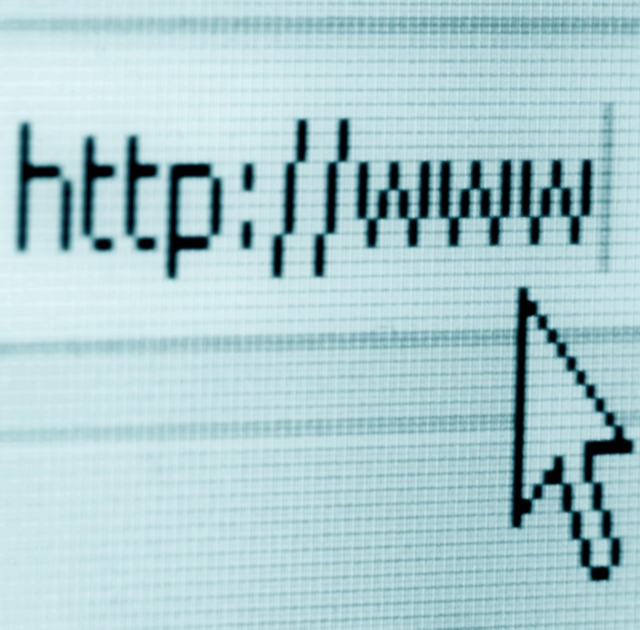
NiRA-Commitment to Nigeria
✓
1
Gainful Employment opportunities
✓
2
Skill Acquisition
✓
3
Capacity Building
✓
4
Job Sourcing
✓
5
Outsourcing to Youths through Call centers, website development
✓
6
Positively Engaged
✓
7
A New and Credible Image for the Youths

Slide 11
.ng Unique Features
The hierarchical structure of the .ng Registry and the restrictions to characters and figures afford certain advantages
The possibility of introducing new second level domains to serve specific trades or interest groups. i.e .police.ng
The potential of exploiting the diverse languages in Nigeria to introduce the IDNs by the introduction of non-Roman characters such as e, i, o, u, c, gb, kp, et cetera.
.eu has implemented this successfully

Slide 12
.ng Unique Features
NIRA is also mindful of the unique opportunity its ccTLD name presents.
With a TLD as .ng, Nigeria’s country code assumes a global significance for many words by coupling of the TLD with any of the vowels of the English language. i.e. Fishi.ng
NIRA intends to exploit these potentials to continue to make .ng a global registry irrespective of the entry of new gTLDs.
The uniqueness of the .ng ccTLD has seen firms like Google, Microsoft Domain Developers Fund taking up googli.ng; bi.ng; et cetera since the Second Level was opened up.

Slide 13
So How Do We Go Forward ?
Charity Begins @HOME with the Federal Government MDAs.
Institute necessary government Policies and mandates for .ng adoption
Holistic Approach to NiRA Growth
Systems- Development and coordination of technical standards, Local administration of key infrastructure
Process- documentation and the operation of critical infrastructures, Policies and Procedures, Regulation and Service delivery
People -Institutional/capacity building; and mobilisation
Products - Creating Local Content with Nigerian centric approach. Local Branding of International Brands e.g. Google.com.ng , thisday.ng
Private Public Partnership for Data and Information security
A Corporate Affairs Commission-Enabled Automated Domain registration via links to NiRA Accredited Registrars websites.
A Nigerian Chamber of Commerce Enabled Automated Domain registration of its members via links to NiRA Accredited Registrars
Engage Nigerian Embassies and Missions Abroad in the promotion and adoption of .ng

Slide 14
So Why Should I Use .NG
.NG (like our currency Naira and +234 for country code) is the official ICANN approved ccTLD for Nigeria
Availability of Names is better on the .ng ccTLD than on the gTLDs like .com, .org.
Branding and Geo targeting of local content to the Nigerian market
Security – Our primary DNS servers are secured and locally managed with multiple Any cast servers located around the world.
Support the Nigerian Economy and provide jobs for local IT professionals
Because you are Patriotic PROUD Nigerian !

Slide 15
How Do I Proceed ?
Determine the name and extension you want to register under. i.e. .com.ng, .org.ng or .name.ng etc.
Choose any of the NiRA Accredited Registrars via our website http://www.nira.org.ng
Search for availability of your chosen name.
If name is available, proceed with Registration.
Relax Now, You are now DOT. NG

